Slide 1

Car Price Prediction
Presented By: Safiya Firdose Khan

Slide 2
Overview:
In this particular presentation we will be looking on:
How to analyze the dataset of Car Price Prediction.
What are the EDA steps in cleaning the dataset.
Overall analysis on the problem.
Model building
Predicting price of used Cars.

Slide 3
Introduction:
With the covid 19 impact in the market, we have seen lot of changes in the car market. Now some cars are in demand hence making them costly and some are not in demand hence cheaper. One of our clients works with small traders, who sell used cars. With the change in market due to covid 19 impact, our client is facing problems with their previous car price valuation machine learning models. So, they are looking for new machine learning models from new data. We have to make car price valuation model.

Slide 4
Business Problem:
Due to the Corona outbreak, many businesses are fighting for their survival and the Automobile industry is also among them. Deals of used cars may boost as a result of the covid-19 pandemic as society should start using private vehicles rather than public.
The second-hand car market which had been noticing a very cold retort during the pandemic is now experiencing a steep incline in sales. More people are preferring private over public vehicles for commuting. Small family cars are in top demand now.

Slide 5
Exploratory Data Analysis:
As a first step I have imported required libraries and I have imported the dataset which is in csv format.
Then, I performed all the statistical analysis, like checking shape, nunique, value counts, info, etc.
While checking the null values in the dataset, I found out that the column VARIANT contains 332 null values, So, I have replace the null values with mode of that column.
Next, I have removed the unnecessary details present in the column FUELTYPE, and renamed it as column FUEL.
I have also removed the unnecessary details present in the columns DRIVEN_KM, PRICE and NOOF_OWNERS.

Slide 6
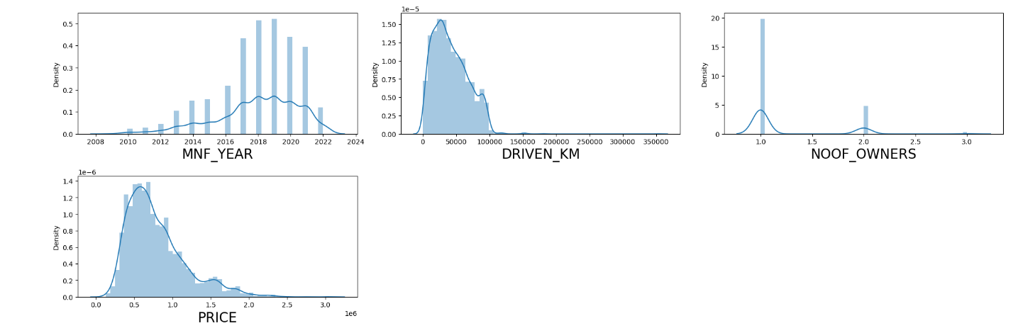
Univariate Analysis for numerical columns:
As we can see, skewness is present in the columns ‘MNF_YEAR’, ‘NOOF_OWNERS’ and ‘PRICE’. The column ‘DRIVEN_KM’ appears to be normal.
As we can see, skewness is present in the columns ‘MNF_YEAR’, ‘NOOF_OWNERS’ and ‘PRICE’. The column ‘DRIVEN_KM’ appears to be normal.

Slide 7
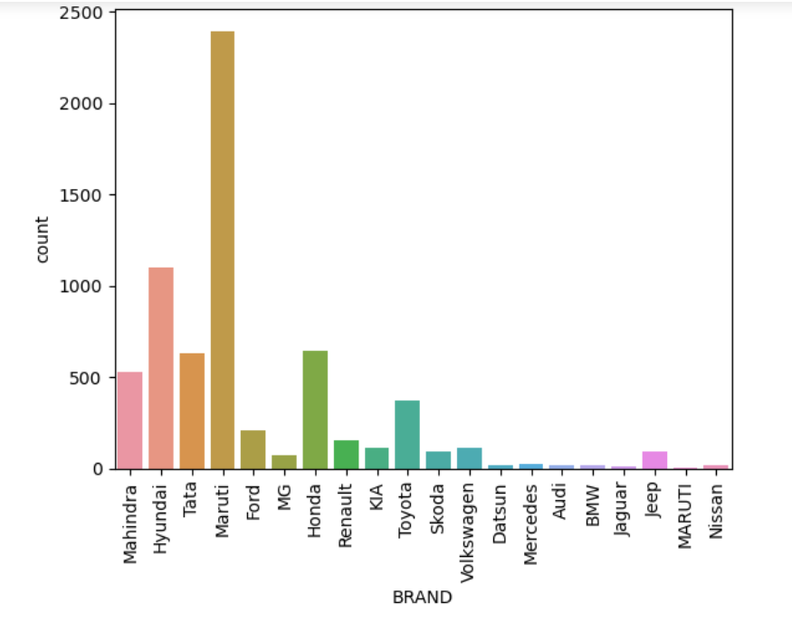
Univariate Analysis for categorical columns:
As we can see, the brand Maruti is largely available for sale, followed by Hyundai.

Slide 8
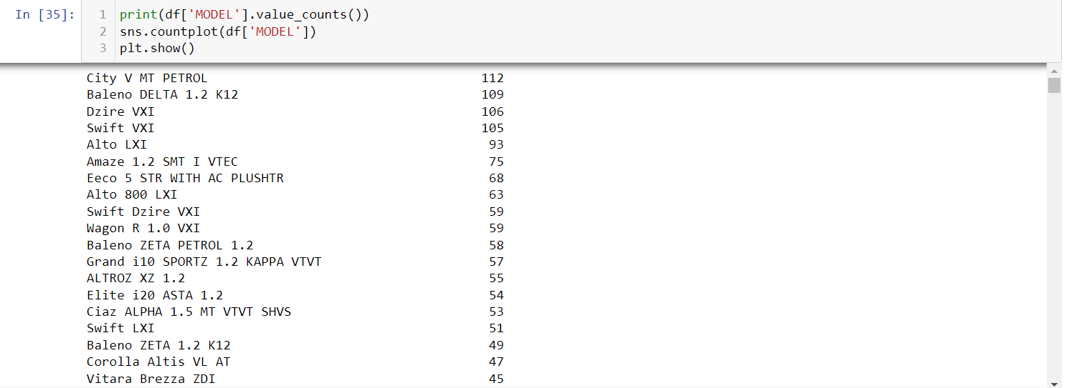
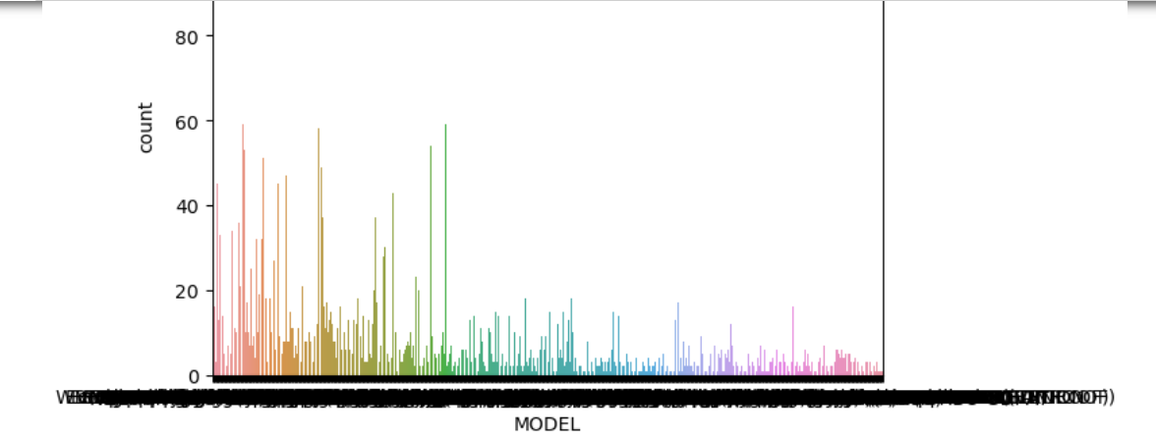
As we can see, the models largely available for sale are “City V MT PETROL”, followed by “Baleno DELTA 1.2 K12” and “Dzire VXI”.

Slide 9
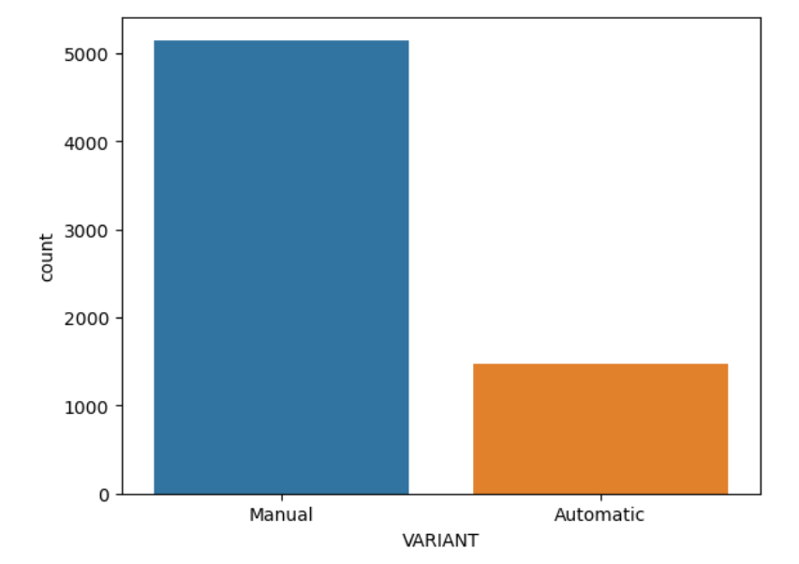
As we can see, the Manual Variants are largely available for sale, as compared to Automatic variants.

Slide 10
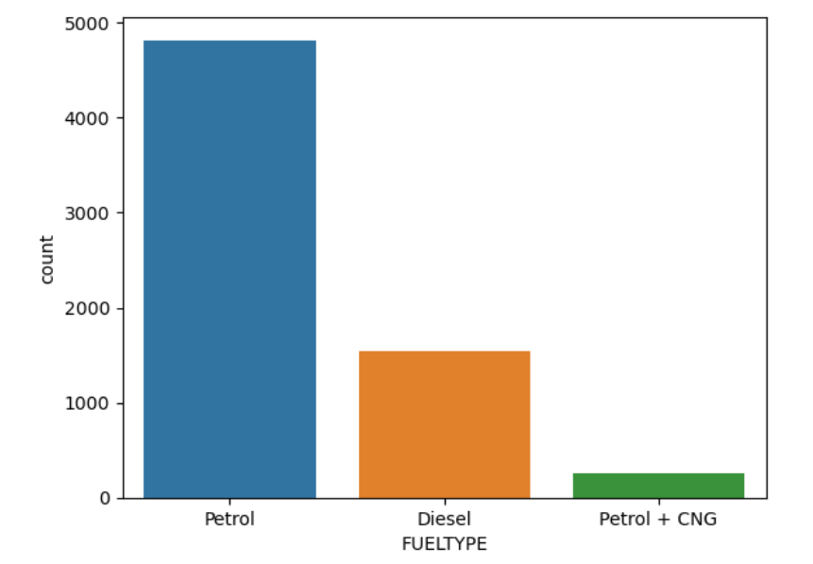
As we can see, the cars with fuel type Petrol are largely available for sale, followed by cars with fuel type Diesel and Petrol+CNG.

Slide 11
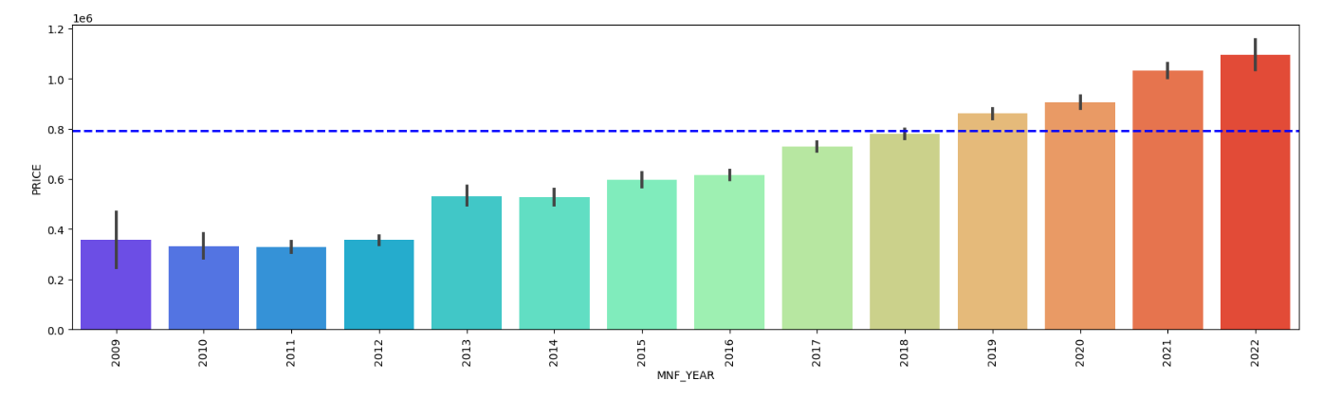
Bivariate Analysis:
As we can see, the cars manufactured in the year 2022 have a higher price, followed by cars manufactured in the year 2021 and 2020.

Slide 12
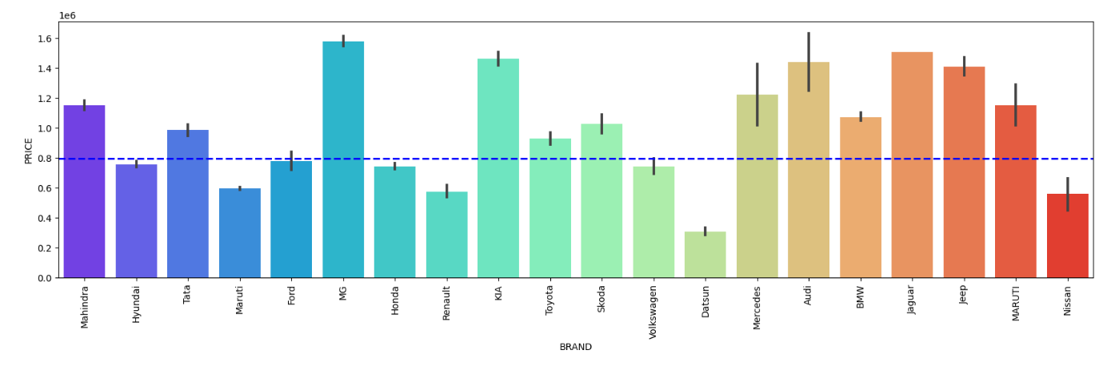
As we can see, the brand “MG” has the highest price, followed by “Jaguar” and “Audi”.

Slide 13
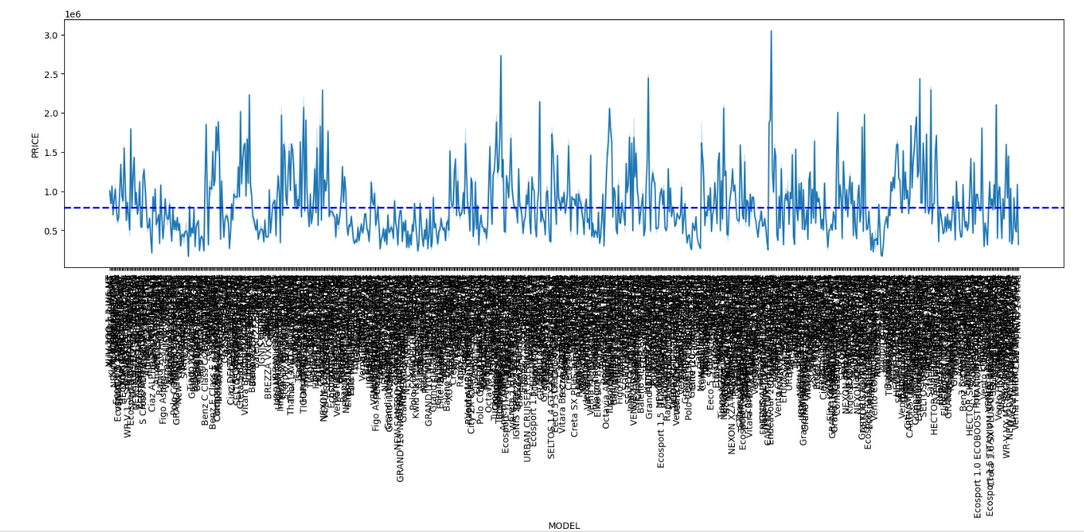
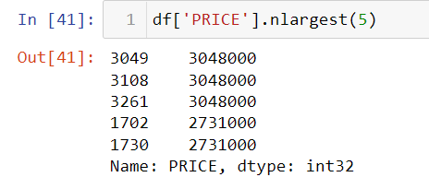
As we can see, the model “Endeavour 2.0 TITANIUM PLUS 4X2 AT” has the highest price, followed by “Endeavour 3.2l 4X4 AT Titanium”.

Slide 14
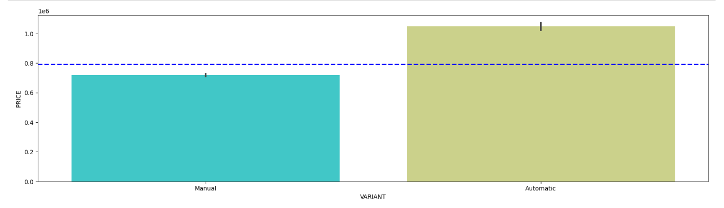
As we can see, the Automatic variant has higher price as compared to Manual variant.

Slide 15
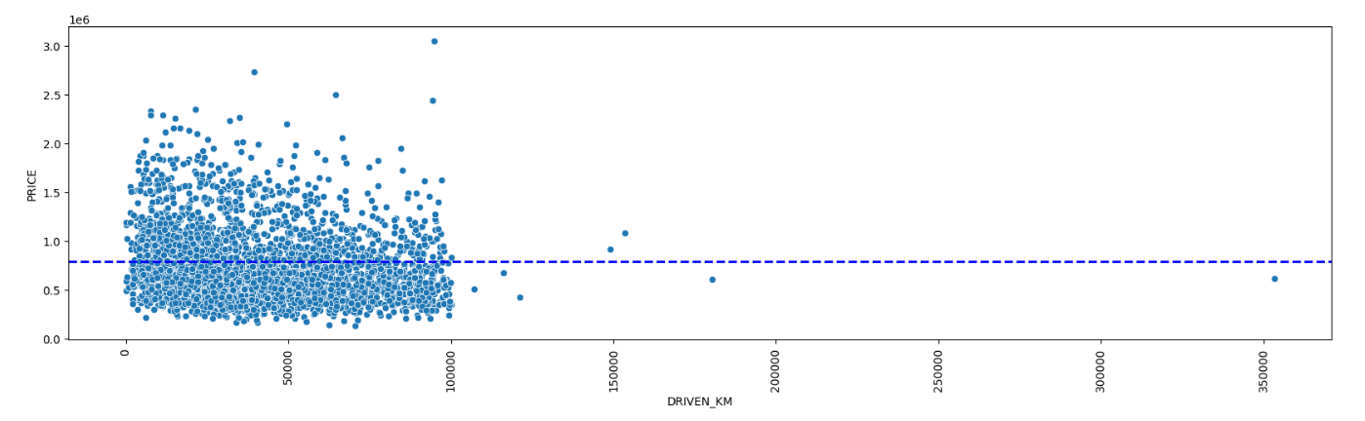
As we can see, the cars which are driven less than 100000 kms have a higher price.

Slide 16
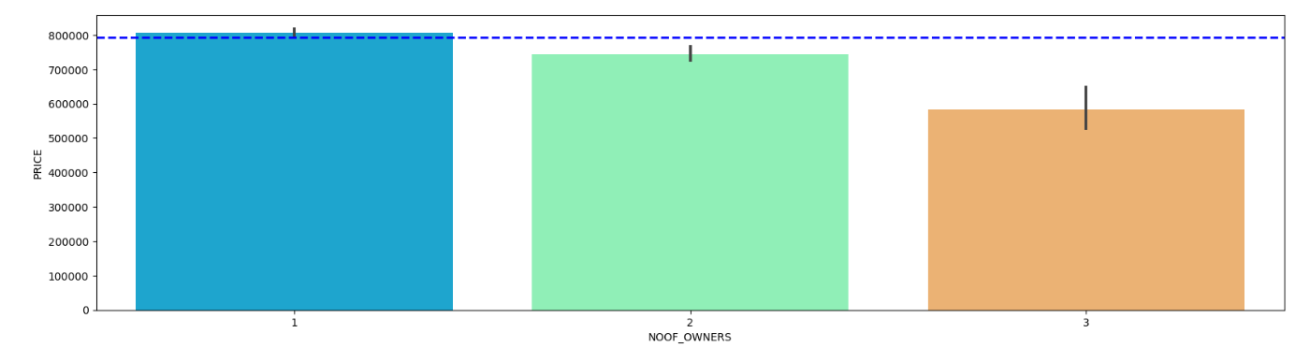
As we can see, the cars with 1 owner have a higher price, followed by cars with 2 owners and 3 owners.

Slide 17
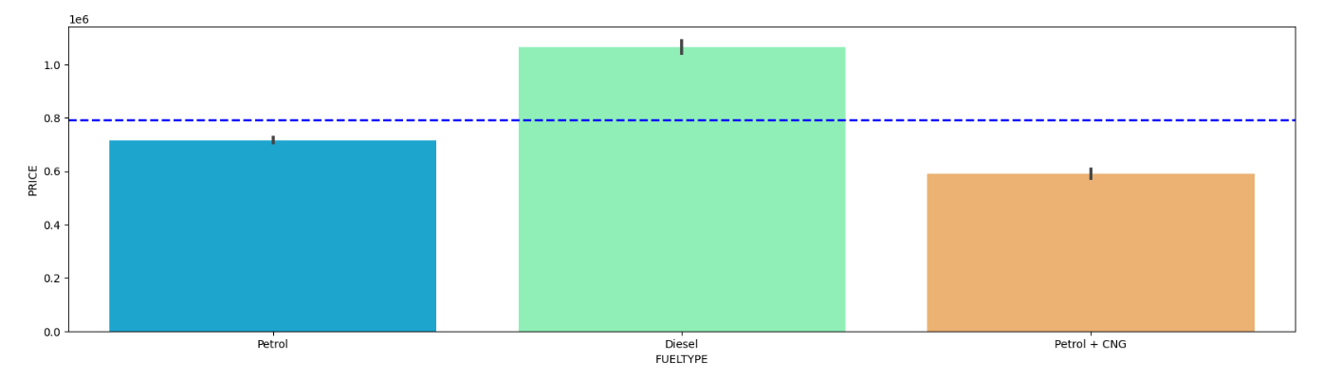
As we can see, the cars with fuel type Diesel have a higher price, followed by cars with fuel type Petrol and Petrol+CNG.

Slide 18
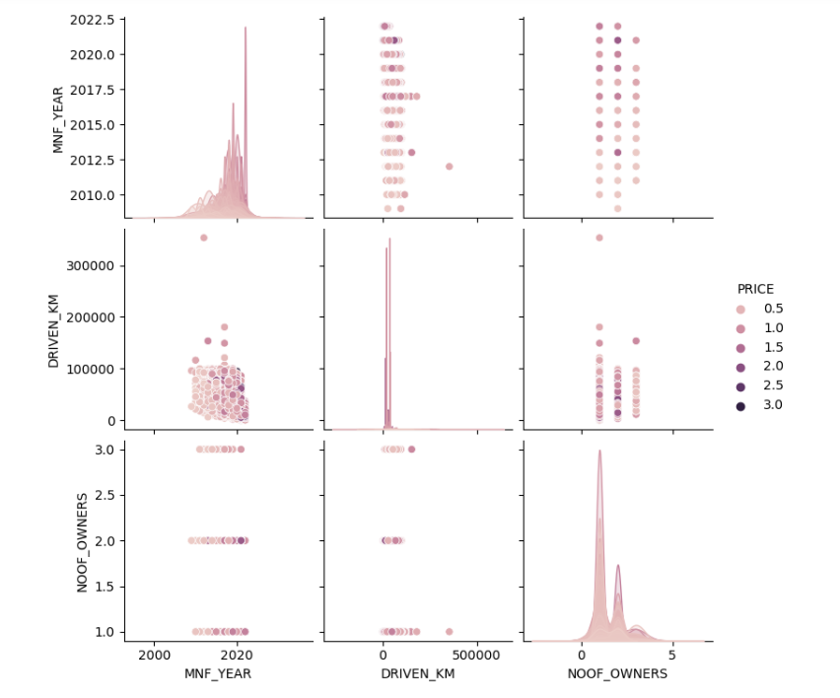
Multivariate Analysis:
The above pairplot gives the pairwise relationship between the columns, which is plotted on the basis of the target variable ‘PRICE’.

Slide 19
Model Building:
Since PRICE is my target variable and it is continuous in nature, so this particular problem is regression problem. I have used all the regression algorithms to build my model. By looking into the difference of r2 score and cross validation score, I found XGBRegressor as the best model with least difference. Also to get the best model, we have to run through multiple models and to avoid the confusion of overfitting we have go through cross validation. Below are the list of regression algorithms I have used in my project.
RandomForestRegressor
XGBRegressor
ExtraTreesRegressor
GradientBoostingRegressor
DecisionTreeRegressor
BaggingRegressor

Slide 20
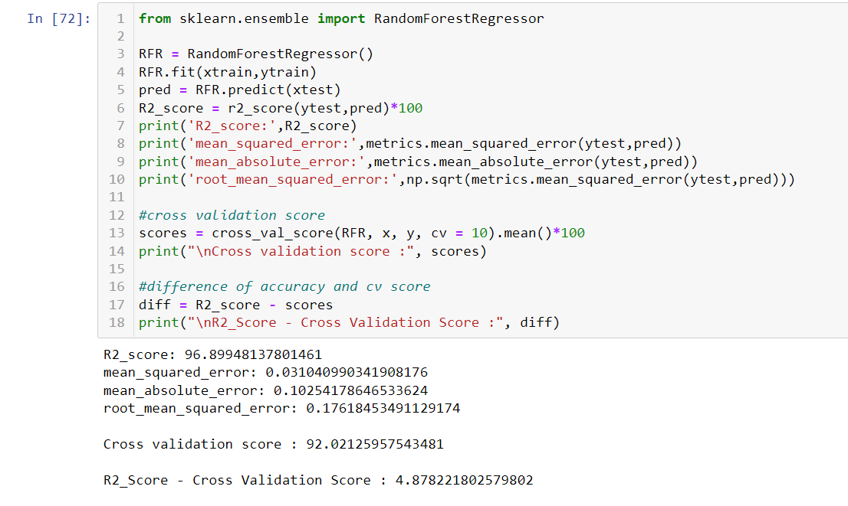
i) Random Forest Regressor:
RandomForestRegressor is giving me 96.89% accuracy.

Slide 21
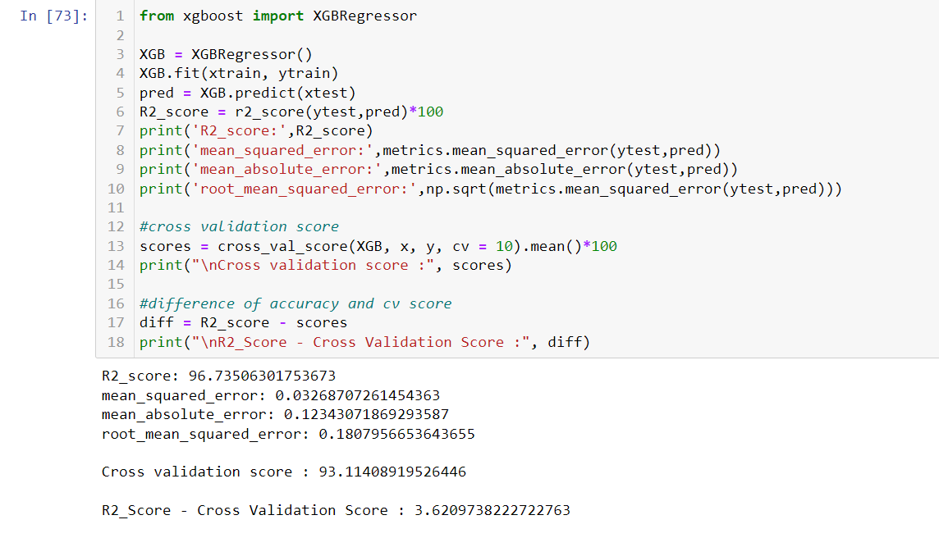
ii) XGB Regressor:
XGB Regressor is giving me 96.73% accuracy.

Slide 22

iii) Extra Trees Regressor:
Extra Trees Regressor is giving me 96.85% accuracy.

Slide 23
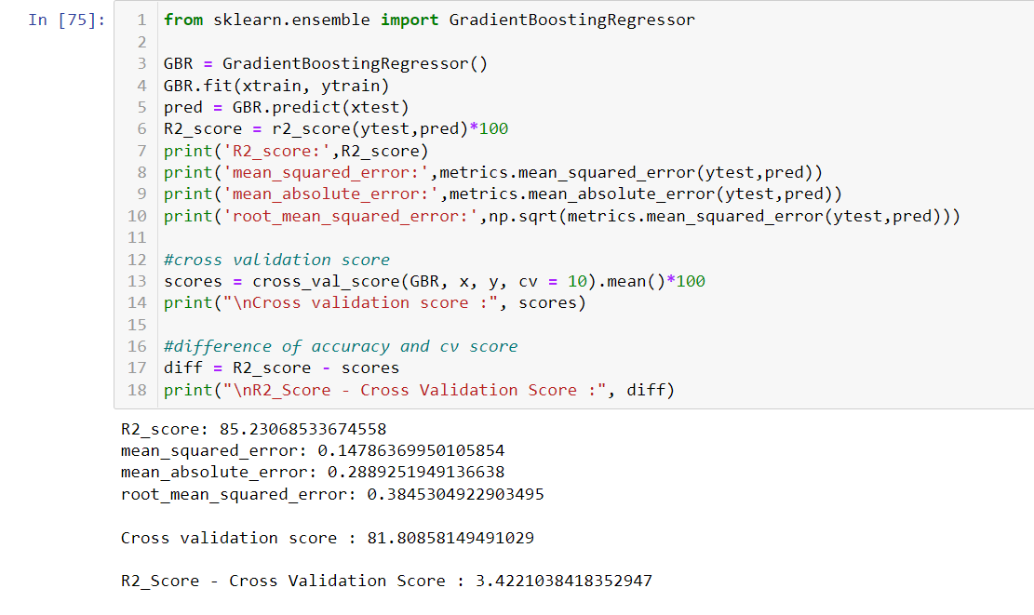
iv) Gradient Boosting Regressor:
Gradient Boosting Regressor is giving me 85.23% accuracy.

Slide 24
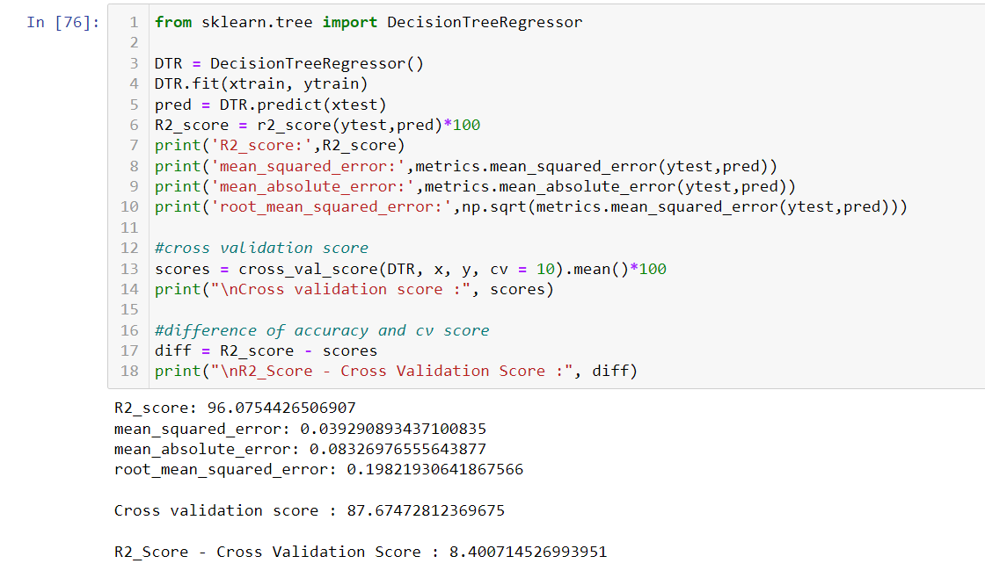
v) Decision Tree Regressor:
Decision Tree Regressoris giving me 96.07% accuracy.

Slide 25
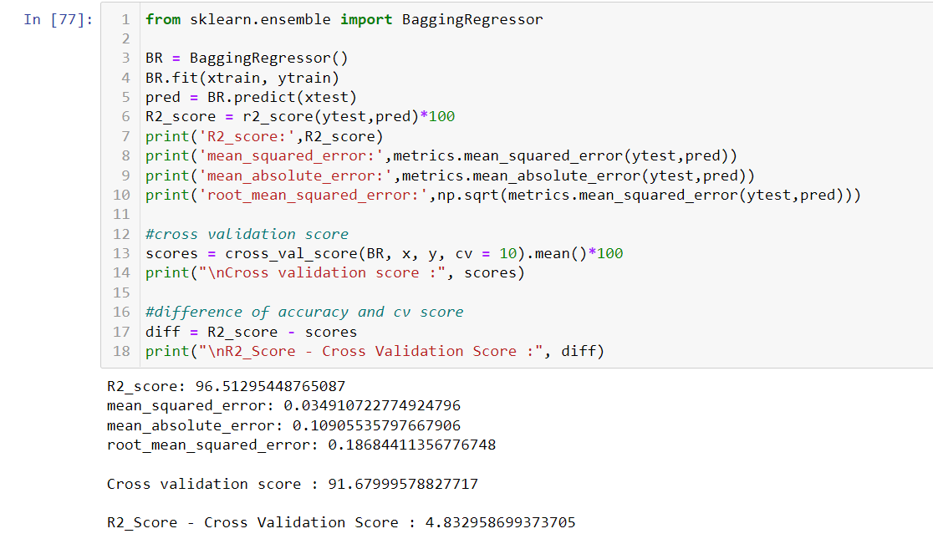
vi) Bagging Regressor:
Bagging Regressor has given me 96.51% accuracy but still we have to look into multiple models.

Slide 26
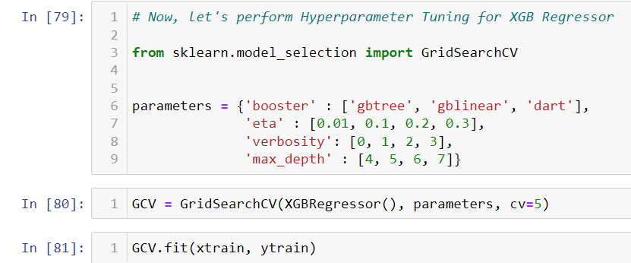
Hyper Parameter Tuning:

Slide 27
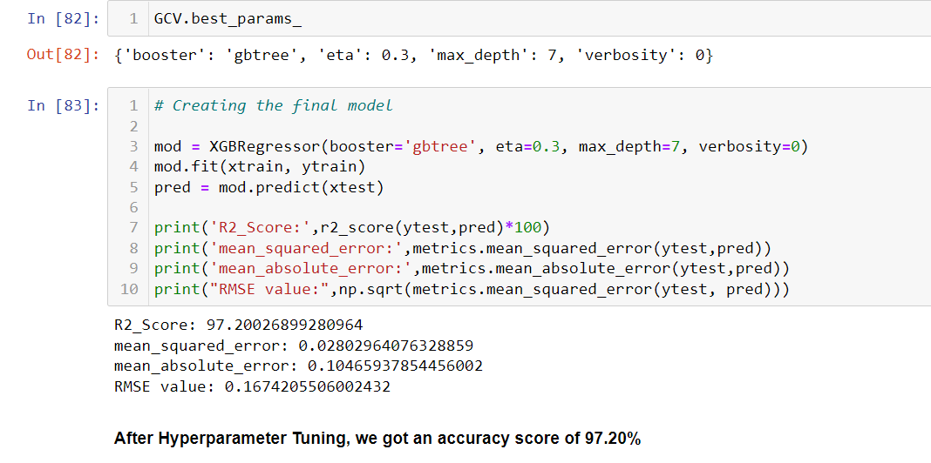
After Hyperparameter tuning, I have increases the accuracy from 96.73% to 97.20%. Also mse and rmse values has reduced which means error has reduced.

Slide 28
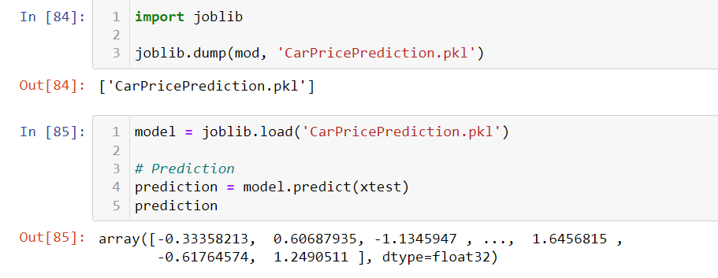
Saving the model and predicting the Price using saved model:
I have saved my best model using .pkl as follows.
After saving the best model, I’m loading my saved model and predicting the test values.

Slide 29
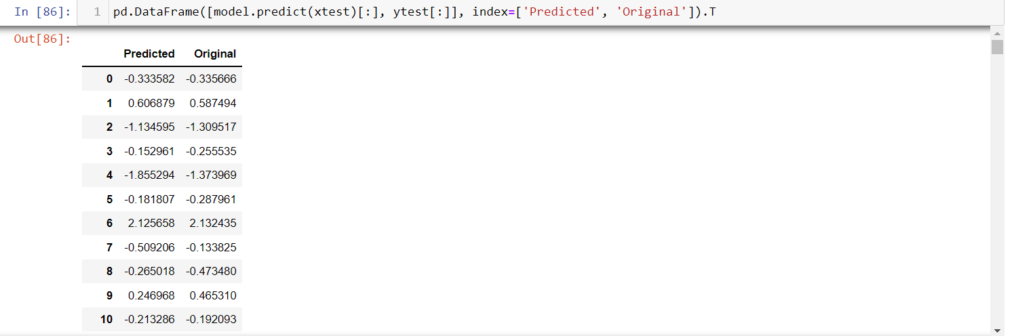

Slide 30
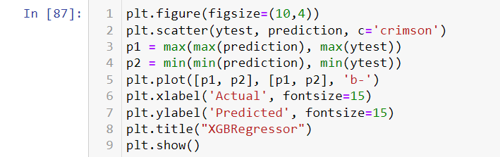
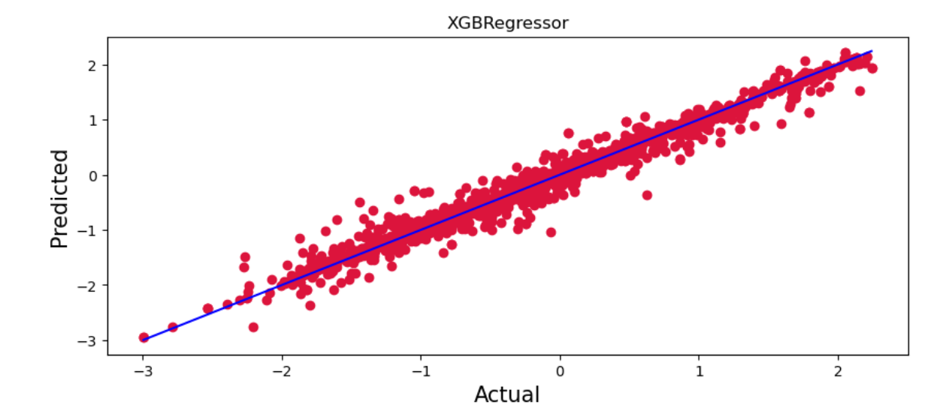

Slide 31
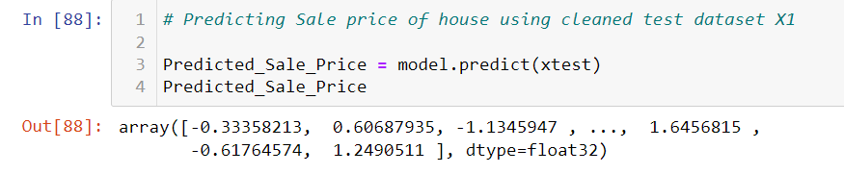
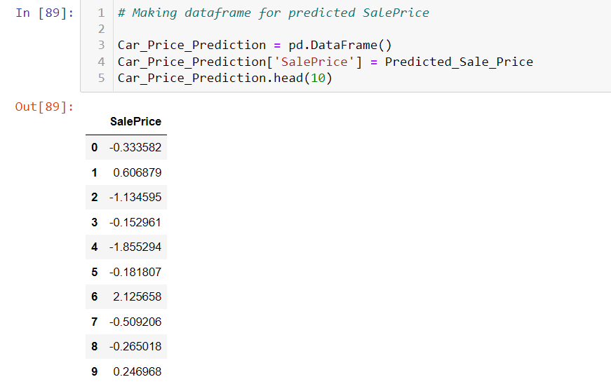

Slide 32
I have predicted the Price for using the saved model, and the predictions look good. I have also saved my predictions for further analysis.

Slide 33
Conclusion:
The cars manufactured in the year 2022 have a higher price, followed by cars manufactured in the year 2021 and 2020. This means that, the latest cars have a higher price.
The brand “MG” has the highest price, followed by “Jaguar” and “Audi”. This means that the luxury cars have a higher price.
The model “Endeavour 2.0 TITANIUM PLUS 4X2 AT” has the highest price, followed by “Endeavour 3.2l 4X4 AT Titanium”.
The Automatic variant has higher price as compared to Manual variant.
The cars which are driven less than 100000 kms have a higher price.
The cars with 1 owner have a higher price, followed by cars with 2 owners and 3 owners. This means that, as the number of owners increases, the price of the car decreases.
The cars with fuel type Diesel have a higher price, followed by cars with fuel type Petrol and Petrol+CNG.

Slide 34


